Slide 1
Mobile Development :
7 : Flutter for Mobile Development : Part 2 More Interactivity, Navigation and Nav Widgets
Professor Imed Bouchrika National School of Artificial Intelligence imed.bouchrika@ensia.edu.dz

Slide 2
Outline :
More on Constructing UIs
More Interactivity
Tic Tac Toe Game
Sliding Number Puzzle
Navigation & Routings
Multiple Screens/Pages
Passing Data.
Expenses App
Navigation Widgets
Sidebar Drawer
Bottom Navigation
Top Bar

Slide 3
Section 1
More Interactivity on a single screen

Slide 4
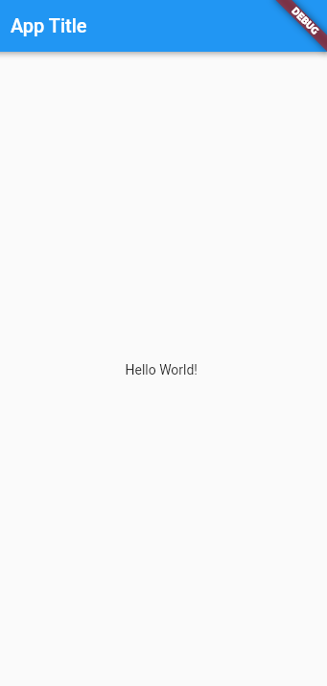

Constructing UIs for Flutter Apps
Skeleton for Building an App

Slide 5
Constructing UIs for Flutter Apps
Skeleton for Building an App
import 'package:flutter/material.dart';
void main() {
runApp(MaterialApp(
home: Scaffold(
appBar: AppBar(title: const Text('App Title')),
body: const Center(
child: Text('Hello World!'),
),
),
));
}

Slide 6
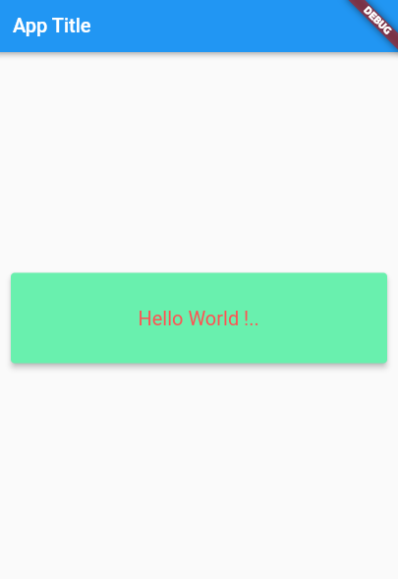
Constructing UIs for Flutter Apps
Skeleton for Building an App : Styling

Slide 7
Constructing UIs for Flutter Apps
import 'package:flutter/material.dart';
void main() {
runApp(MaterialApp(
home: Scaffold(
appBar: AppBar(title: const Text('App Title')),
body: Center(
child: Container(
margin: EdgeInsets.all(10),
width: double.infinity,
height: 100,
child: Card(
color: Colors.greenAccent,
elevation: 5,
child: Center(
child: Text(
'Hello World !..',
style: TextStyle( fontSize: 20, color: Colors.redAccent),
)))),
),
),
));
}
Skeleton for Building an App : Styling

Slide 8
Constructing UIs for Flutter Apps
import 'package:flutter/material.dart';
import 'package:reminder_flutter_hello_world_two/widgets/myWidget.dart';
void main() {
runApp(const MainApp());
}
class MainApp extends StatelessWidget {
const MainApp({super.key});
@override
Widget build(BuildContext context) {
return MaterialApp(
home: Scaffold(
appBar: AppBar(title: const Text('App Title')),
body: const Center(
child: Column(children: [
Text('Hello World!'),
SizedBox(height: 30),
myWidget(),
])),
),
);
}
}
Either Encapsulate Widgets via:
Widget Class with a Build Method
A Function that returns a Widget

Slide 9
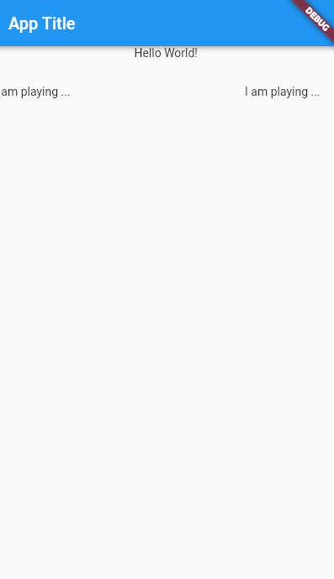
Constructing UIs for Flutter Apps
import 'package:flutter/material.dart';
import 'package:reminder_flutter_hello_world_two/widgets/myWidget.dart';
void main() {
runApp(const MainApp());
}
class MainApp extends StatelessWidget {
const MainApp({super.key});
@override
Widget build(BuildContext context) {
return MaterialApp(
home: Scaffold(
appBar: AppBar(title: const Text('App Title')),
body: const Center(
child: Column(children: [
Text('Hello World!'),
SizedBox(height: 30),
myWidget(),
])),
),
);
}
}
Either Encapsulate Widgets via:
Widget Class with a Build Method
A Function that returns a Widget
import 'package:flutter/material.dart';
class myWidget extends StatelessWidget {
const myWidget({super.key});
@override
Widget build(BuildContext context) {
return const Row(
children: [
Text('I am playing ...'),
Spacer(),
Text('I am playing ...'),
SizedBox(width: 20),
],
);
}
}
Constructor is defined to take the super.key

Slide 10
Constructing UIs for Flutter Apps
import 'package:flutter/material.dart';
import 'package:reminder_flutter_hello_world_two/widgets/myWidget.dart';
void main() {
runApp(const MainApp());
}
class MainApp extends StatelessWidget {
const MainApp({super.key});
@override
Widget build(BuildContext context) {
return MaterialApp(
home: Scaffold(
appBar: AppBar(title: const Text('App Title')),
body: const Center(
child: Column(children: [
Text('Hello World!'),
SizedBox(height: 30),
getMyWidget(),
])),
),
);
}
}
Either Encapsulate Widgets via:
A Function that returns a Widget
import 'package:flutter/material.dart';
Widget getMyWidget() {
return const Row(
children: [
Text('I am playing ...'),
Spacer(),
Text('I am playing ...'),
SizedBox(width: 20),
],
);
}

Slide 11
Constructing UIs for Flutter Apps
Stateful Widget
import 'package:flutter/material.dart';
class MyStatefulWidget extends StatefulWidget {
var myStart = 0;
MyStatefulWidget({super.key, this.myStart = 0});
@override
_MyStatefulWidgetState createState() => _MyStatefulWidgetState();
}
class _MyStatefulWidgetState extends State<MyStatefulWidget> {
@override
Widget build(BuildContext context) {
return Text('Value is ${widget.myStart}');
}
}
The stateful widget Constructor takes another real argument to be used.

Slide 12
Constructing UIs for Flutter Apps
Stateful Widget
import 'package:flutter/material.dart';
class MyStatefulWidget extends StatefulWidget {
var myStart = 0;
MyStatefulWidget({super.key, this.myStart = 0});
@override
_MyStatefulWidgetState createState() => _MyStatefulWidgetState();
}
class _MyStatefulWidgetState extends State<MyStatefulWidget> {
@override
Widget build(BuildContext context) {
return Text('Value is ${widget.myStart}');
}
}
To access data of the Widget from the state instance, use : widget.varName

Slide 13
Constructing UIs for Flutter Apps
import 'package:flutter/material.dart';
import 'package:reminder_flutter_hello_world_two/widgets/myStatefulWidget.dart';
import 'package:reminder_flutter_hello_world_two/widgets/myWidget.dart';
void main() {
runApp(const MainApp());
}
class MainApp extends StatelessWidget {
const MainApp({super.key});
@override
Widget build(BuildContext context) {
return MaterialApp(
home: Scaffold(
appBar: AppBar(title: const Text('App Title')),
body: Center(
child: Column(children: [
const Text('Hello World!'),
const SizedBox(height: 30),
const myWidget(),
const SizedBox(height: 30),
const Text('Below is a stateful Widget'),
const SizedBox(height: 30),
MyStatefulWidget(),
])),
),
);
}
}
Stateful Widget
Stateless and Stateful Widgets are integrated into the UI by calling the constructor.
No argument is given for the stateful Widget

Slide 14
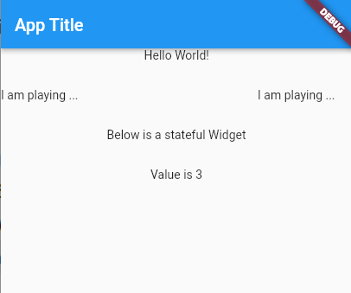
Constructing UIs for Flutter Apps
import 'package:flutter/material.dart';
import 'package:reminder_flutter_hello_world_two/widgets/myStatefulWidget.dart';
import 'package:reminder_flutter_hello_world_two/widgets/myWidget.dart';
void main() {
runApp(const MainApp());
}
class MainApp extends StatelessWidget {
const MainApp({super.key});
@override
Widget build(BuildContext context) {
return MaterialApp(
home: Scaffold(
appBar: AppBar(title: const Text('App Title')),
body: Center(
child: Column(children: [
const Text('Hello World!'),
const SizedBox(height: 30),
const myWidget(),
const SizedBox(height: 30),
const Text('Below is a stateful Widget'),
const SizedBox(height: 30),
MyStatefulWidget(myStart:3),
])),
),
);
}
}
Stateful Widget
To pass an argument into the contructor of the Stateful Widget

Slide 15
Constructing UIs for Flutter Apps
import 'package:flutter/material.dart';
class MyStatefulWidget extends StatefulWidget {
var myStart = 0;
MyStatefulWidget({super.key, this.myStart = 0});
@override
_MyStatefulWidgetState createState() => _MyStatefulWidgetState();
}
class _MyStatefulWidgetState extends State<MyStatefulWidget> {
int increment = 0;
@override
void initState() {
super.initState();
increment = widget.myStart;
}
@override
Widget build(BuildContext context) {
return Column(children: [
Text('Value is $increment'),
SizedBox(height: 10),
ElevatedButton(
onPressed: () {
increment = increment + 1;
setState(() {});
},
child: const Text('Increment'))
]);
}
}
Stateful Widget
initState is invoked only one time once the widget is initialized.
Vs
The method build is called often whenever a refresh is required.

Slide 16
Constructing UIs for Flutter Apps
import 'package:flutter/material.dart';
class MyStatefulWidget extends StatefulWidget {
var myStart = 0;
MyStatefulWidget({super.key, this.myStart = 0});
@override
_MyStatefulWidgetState createState() => _MyStatefulWidgetState();
}
class _MyStatefulWidgetState extends State<MyStatefulWidget> {
int increment = 0;
@override
void initState() {
super.initState();
increment = widget.myStart;
}
@override
Widget build(BuildContext context) {
return Column(children: [
Text('Value is $increment'),
SizedBox(height: 10),
ElevatedButton(
onPressed: () {
increment = increment + 1;
setState(() {});
},
child: const Text('Increment'))
]);
}
}
Stateful Widget
setState( (){} ); Is called to invoke the build method of the stateful widget state.
= Refresh the UI of the widget

Slide 17
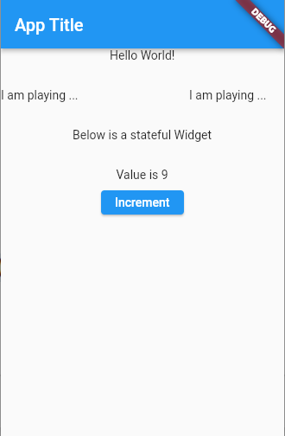
Constructing UIs for Flutter Apps
import 'package:flutter/material.dart';
import 'package:reminder_flutter_hello_world_two/widgets/myStatefulWidget.dart';
import 'package:reminder_flutter_hello_world_two/widgets/myWidget.dart';
void main() {
runApp(const MainApp());
}
class MainApp extends StatelessWidget {
const MainApp({super.key});
@override
Widget build(BuildContext context) {
return MaterialApp(
home: Scaffold(
appBar: AppBar(title: const Text('App Title')),
body: Center(
child: Column(children: [
const Text('Hello World!'),
const SizedBox(height: 30),
const myWidget(),
const SizedBox(height: 30),
const Text('Below is a stateful Widget'),
const SizedBox(height: 30),
MyStatefulWidget(myStart: 3),
])),
),
);
}
}
Stateful Widget
Screen

Slide 18
Constructing UIs for Flutter Apps
MaterialApp
Scaffold
A Tree of Widgets
Center
Column
Text
Column
Padding
Container
Row
Text
Column
Text

Slide 19
Constructing UIs for Flutter Apps
Scaffold : appBar, body, floatingActionButton, drawer, bottomNavigationBar
AppBar : title , leading, elevation
Container : child, padding, margin, height, width,decoration alignment
Column : children, mainAxisAlignment, crossAxisAlignment
Row : children, mainAxisAlignment, crossAxisAlignment
Stack : alignment, children,
SizedBox : child ,height, width ,
Card : child, color, elevation, margin, clipBehavior, shape
Expanded : child, flex
Spacer : flex
Padding : padding --> EdgeInsets.all|only|fromLTRB|symmetric
Center : child
Align : child,alignment
ListView.builder :scrollDirection, physics, itemCount, itemBuilder(context,index)
GridView.builder : padding, physics, itemCount, itemBuilder(context,index)
Text : style, textAlign
TextFormField :onChanged, controller, decoration, validator
ElevatedButton :style, onPressed, child
IconButton : icon, onPressed
Icon : color, size,
Slider :value, max, divisions, onChanged, label
Switch :value, onChanged, thumbIcon
ListTile : leading, title, subtitle, trailing, tileColor, onTap
Image.asset : imagepath,
TextStyle : fontSize, color, fontWeigth
BoxDecoration : image, shape, border, borderRaduis, color
Opacity : opacity, child
RoundedRectangleBorder :borderRadius, side
Position : left, bottom, right, top
BoxShadow : color, offset, blurStyle

Slide 20
Constructing UIs for Flutter Apps
Getting Help ! Speeding up the learning curve
To get the list of attributes for a Widget, hover over the Widget
Use VS Code refactoring Tools to wrap widgets by Container Widgets ( Container, Row, Column…etc)

Slide 21
Constructing UIs for Flutter Apps
Questions
Final vs Const :
final : The Value must be initialized during the declaration and will never change
const : The value will be computed during compile time and will never change later during execution.
Why use const : To optimize the performance of flutter via the reuse of the same constant widgets.

Slide 22
Constructing UIs for Flutter Apps
Questions
? vs ?. vs ?? vs !!
? : To say a variable can take the value Null during the declaration
String? name ;
?. : to avoid null pointer exception and return null :
return person?.name
For the case when person is null, it returns null directly without accessing name
?? : If the null, return the value on the right side:
return person??Person()
If person is null, instantiate a new Person and return it.
! : To cast away nullability ( or simply get rid of the warnings )
return person!.name ( Compiler will complain that person is nullable, we cast it to non-nullable. Warning : you use this only when you are completely certain that the object is non-nullable

Slide 23
Constructing UIs for Flutter Apps
Questions
Set vs Map vs List
Set is {‘one’, ‘two’, ‘three’} not like Python

Slide 24
More Interactivity for Flutter Apps
Tic Tac Toe Game
Reminder how we did it in Native Android using Kotlin
Do the XML Widget
Putting the business logic inside Kotlin
Registering EventListener
Whenever they click on a TextView, we check, if empty, we set its text to the current player symbol
We check if there is a win

Slide 25
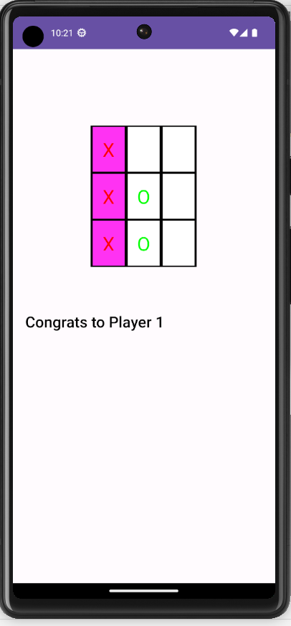
var win=checkWin()
if (win){
findViewById<TextView>(R.id.tx_turn).setText("Congrats to Player "+turn)
gameover=true
return
}
turn=if (turn==1) 2 else 1
findViewById<TextView>(R.id.tx_turn).setText("Turn of Player: "+turn)
}
var possible_wins= arrayOf(
arrayOf(R.id.tx_a1,R.id.tx_a2,R.id.tx_a3),
arrayOf(R.id.tx_a4,R.id.tx_a5,R.id.tx_a6),
arrayOf(R.id.tx_a7,R.id.tx_a8,R.id.tx_a9),
arrayOf(R.id.tx_a1,R.id.tx_a5,R.id.tx_a9),
arrayOf(R.id.tx_a7,R.id.tx_a5,R.id.tx_a3),
arrayOf(R.id.tx_a1,R.id.tx_a4,R.id.tx_a7),
arrayOf(R.id.tx_a2,R.id.tx_a5,R.id.tx_a8),
arrayOf(R.id.tx_a3,R.id.tx_a6,R.id.tx_a9))
fun checkWin(): Boolean{
for (possible in possible_wins){
var seqStr=""
for (cellId in possible){
var existingValue:String=findViewById<TextView>(cellId).text.toString()
if (existingValue.length==0)break
seqStr=seqStr+existingValue
}
if (seqStr=="OOO" || seqStr=="XXX") {
for (cellId in possible){
findViewById<TextView>(cellId).setBackgroundColor(Color.parseColor("#eeeeee"))
}
return true
}
}
return false
}

Slide 26
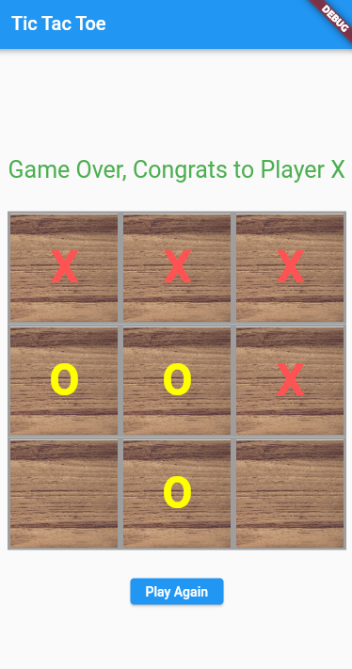
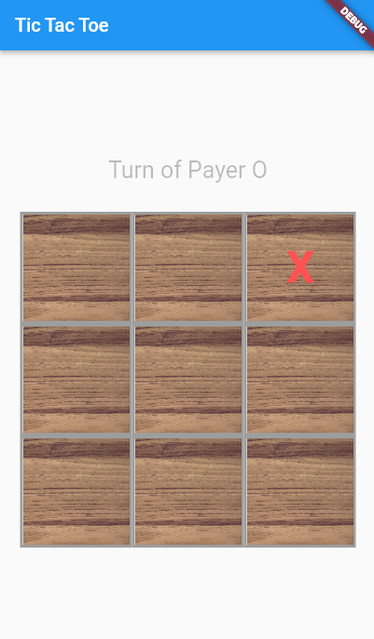
More Interactivity for Flutter Apps
Tic Tac Toe Game
How to design using Flutter ?

Slide 27
MaterialApp
home : Scaffold
appBar: Appbar
body: Column

Slide 28
MaterialApp
home : Scaffold
appBar: Appbar
title: Text
body: Column
Text
Row X 3
Cell X 3
Button

Slide 29
MaterialApp
home : Scaffold
If (gameover)
appBar: Appbar
title: Text
body: Column
Text
Row X 3
Cell X 3
If (gameover)
Button

Slide 30
MaterialApp
home : Scaffold
appBar: Appbar
Visibility
Text
body: Column
Row X 3
Cell X 3
Visibility
Button

Slide 31
More Interactivity for Flutter Apps
import 'package:flutter/material.dart';
import 'package:tic_tac_toe_no_bl/screens/homescreen.dart';
void main() {
runApp(const MainApp());
}
class MainApp extends StatelessWidget {
const MainApp({super.key});
@override
Widget build(BuildContext context) {
return MaterialApp(
home: HomeScreen(),
);
}
}
//homescreen.dart
import 'package:flutter/material.dart';
class HomeScreen extends StatefulWidget {
@override
_HomeScreenState createState() => _HomeScreenState();
}
class _HomeScreenState extends State<HomeScreen> {
var boardSize = 3;
var currentPlayer = 'X';
@override
Widget build(BuildContext context) {
return Scaffold(
appBar: AppBar(title: const Text('Tic Tac Toe')),
body: Center(
child: Column(
mainAxisAlignment: MainAxisAlignment.center,
crossAxisAlignment: CrossAxisAlignment.center,
children: [
Tic Tac Toe Game
Create it using Flutter

Slide 32
More Interactivity for Flutter Apps
children: [
SizedBox(height: 40),
Visibility(visible: false,
child: Text(
'Game Over, Congrats to Player X',
style: TextStyle(color: Colors.green, fontSize: 25),
),
),
Visibility(visible: true,
child: Text(
'Turn of Payer $currentPlayer',
style: TextStyle(color: Colors.black26, fontSize: 25),
),
),
SizedBox(height: 30),
for (int row = 0; row < boardSize; row++)
Row(
mainAxisAlignment: MainAxisAlignment.center,
crossAxisAlignment: CrossAxisAlignment.center,
children: [
for (int col = 0; col < boardSize; col++) getCell()
],
),
SizedBox(height: 30),
Visibility(
visible: true,
child: ElevatedButton(
onPressed: () {
setState(() {});
},
child: Text("Play Again")),
)
]
Tic Tac Toe Game
Create it using Flutter

Slide 33
More Interactivity for Flutter Apps
Widget getCell() {
return GestureDetector(
onTap: () {},
child: Container(
decoration: BoxDecoration(
border: Border.all(color: Colors.grey, width: 3),
),
width: 120,
height: 120,
child: Stack(
children: [
Positioned.fill(
child: Opacity(
opacity: 0.8,
child: Image.asset('assets/images/wood.png', fit: BoxFit.cover),
),
),
Center(
child: Text('',
style: TextStyle(
fontSize: 45,
fontWeight: FontWeight.bold,
))),
],
),
),
);
}
}
Tic Tac Toe Game
Create it using Flutter

Slide 34
More Interactivity for Flutter Apps
//homescreen.dart
import 'package:flutter/material.dart';
class HomeScreen extends StatefulWidget {
@override
_HomeScreenState createState() => _HomeScreenState();
}
class _HomeScreenState extends State<HomeScreen> {
var boardSize = 3;
var currentPlayer = 'X'; Map<String, String> data = {};
bool gameover = false;
@override
Widget build(BuildContext context) {
return Scaffold(
appBar: AppBar(title: const Text('Tic Tac Toe')),
body: Center(
child: Column(
mainAxisAlignment: MainAxisAlignment.center,
crossAxisAlignment: CrossAxisAlignment.center,
children: [
Tic Tac Toe Game
Create it using Flutter

Slide 35
More Interactivity for Flutter Apps
//homescreen.dart
import 'package:flutter/material.dart';
class HomeScreen extends StatefulWidget {
@override
_HomeScreenState createState() => _HomeScreenState();
}
class _HomeScreenState extends State<HomeScreen> {
var boardSize = 3;
var currentPlayer = 'X'; Map<String, String> data = {};
bool gameover = false;
void init_game_data() {
data = {};
gameover = false;
currentPlayer = 'X';
for (int r = 0; r < boardSize; r++) {
for (int c = 0; c < boardSize; c++) {
data[r.toString() + "x" + c.toString()] = '';
}
}
}
@override
Widget build(BuildContext context) {
return Scaffold(
appBar: AppBar(title: const Text('Tic Tac Toe')),
body: Center(
child: Column(
mainAxisAlignment: MainAxisAlignment.center,
crossAxisAlignment: CrossAxisAlignment.center,
children: [
Tic Tac Toe Game
Create it using Flutter

Slide 36
More Interactivity for Flutter Apps
import 'package:flutter/material.dart';
class HomeScreen extends StatefulWidget {
@override
_HomeScreenState createState() => _HomeScreenState();
}
class _HomeScreenState extends State<HomeScreen> {
var boardSize = 3;
var currentPlayer = 'X'; Map<String, String> data = {};
bool gameover = false;
void init_game_data() {
data = {};
gameover = false;
currentPlayer = 'X';
for (int r = 0; r < boardSize; r++) {
for (int c = 0; c < boardSize; c++) {
data[r.toString() + "x" + c.toString()] = '';
}
}
}
@override
void initState() {
super.initState(); init_game_data();
}
Tic Tac Toe Game
Create it using Flutter

Slide 37
More Interactivity for Flutter Apps
Widget getCell() {
return GestureDetector(
onTap: () {},
child: Container(
decoration: BoxDecoration(
border: Border.all(color: Colors.grey, width: 3),
),
width: 120,
height: 120,
child: Stack(
children: [
Positioned.fill(
child: Opacity(
opacity: 0.8,
child: Image.asset('assets/images/wood.png', fit: BoxFit.cover),
),
),
Center(
child: Text('',
style: TextStyle(
fontSize: 45,
fontWeight: FontWeight.bold,
))),
],
),
),
);
}
}
Tic Tac Toe Game
Create it using Flutter

Slide 38
More Interactivity for Flutter Apps
Widget getCell(int row, int col) { var dataKey = row.toString() + "x" + col.toString();
Color myColor = Colors.redAccent;
if (data[dataKey] == 'O') myColor = Colors.yellowAccent;
return GestureDetector(
onTap: () {},
child: Container(
decoration: BoxDecoration(
border: Border.all(color: Colors.grey, width: 3),
),
width: 120,
height: 120,
child: Stack(
children: [
Positioned.fill(
child: Opacity(
opacity: 0.8,
child: Image.asset('assets/images/wood.png', fit: BoxFit.cover),
),
),
Center(
child: Text('',
style: TextStyle(
fontSize: 45,
fontWeight: FontWeight.bold,
))),
],
),
),
);
}
}
Tic Tac Toe Game
Create it using Flutter

Slide 39
More Interactivity for Flutter Apps
Widget getCell(int row, int col) { var dataKey = row.toString() + "x" + col.toString();
Color myColor = Colors.redAccent;
if (data[dataKey] == 'O') myColor = Colors.yellowAccent;
return GestureDetector(
onTap: () {
if (gameover) return;
if (data[dataKey] == '') {
data[dataKey] = currentPlayer;
gameover = isWin();
if (!gameover) {
switchPlayerTurn();
}
setState(() {});
},
child: Container(
decoration: BoxDecoration(
border: Border.all(color: Colors.grey, width: 3),
),
width: 120,
height: 120,
child: Stack(
children: [
Positioned.fill(
child: Opacity(
opacity: 0.8,
child: Image.asset('assets/images/wood.png', fit: BoxFit.cover),
),
),
Center(
child: Text('',
style: TextStyle(
fontSize: 45,
fontWeight: FontWeight.bold,
))),
],
),
),
);
}
}
Tic Tac Toe Game
Create it using Flutter

Slide 40
More Interactivity for Flutter Apps
List<List<String>> possible_wins = [
['0x0', '0x1', '0x2'],
['1x0', '1x1', '1x2'],
['2x0', '2x1', '2x2'],
['0x0', '1x0', '2x0'],
['0x1', '1x1', '2x1'],
['0x2', '1x2', '2x2'],
['0x0', '1x1', '2x2'],
['0x2', '1x1', '2x0'],
];
bool isWin() {
for (var line in possible_wins) {
var result = '';
for (var cell in line) {
result = result + data[cell]!;
}
if (result == 'XXX' || result == 'OOO') {
gameover = true;
return true;
}
}
return false;
}
void switchPlayerTurn() {
if (currentPlayer == 'X') {
currentPlayer = 'O';
} else {
currentPlayer = 'X';
}
}
Widget getCell(int row, int col) { var dataKey = row.toString() + "x" + col.toString();
Color myColor = Colors.redAccent;
if (data[dataKey] == 'O') myColor = Colors.yellowAccent;
return GestureDetector(
onTap: () {
if (gameover) return;
if (data[dataKey] == '') {
data[dataKey] = currentPlayer;
gameover = isWin();
if (!gameover) {
switchPlayerTurn();
}
setState(() {});
},
child: Container(
decoration: BoxDecoration(
border: Border.all(color: Colors.grey, width: 3),
),
width: 120,
height: 120,
child: Stack(
children: [
Positioned.fill(
child: Opacity(
opacity: 0.8,
child: Image.asset('assets/images/wood.png', fit: BoxFit.cover),
),
),
Center(
child: Text('',
style: TextStyle(
fontSize: 45,
fontWeight: FontWeight.bold,
))),
],
),
),
);
}
}
Tic Tac Toe Game
Create it using Flutter

Slide 41
More Interactivity for Flutter Apps
List<List<String>> possible_wins = [
['0x0', '0x1', '0x2'],
['1x0', '1x1', '1x2'],
['2x0', '2x1', '2x2'],
['0x0', '1x0', '2x0'],
['0x1', '1x1', '2x1'],
['0x2', '1x2', '2x2'],
['0x0', '1x1', '2x2'],
['0x2', '1x1', '2x0'],
];
bool isWin() {
for (var line in possible_wins) {
var result = '';
for (var cell in line) {
result = result + data[cell]!;
}
if (result == 'XXX' || result == 'OOO') {
gameover = true;
return true;
}
}
return false;
}
void switchPlayerTurn() {
if (currentPlayer == 'X') {
currentPlayer = 'O';
} else {
currentPlayer = 'X';
}
}
Widget getCell(int row, int col) { var dataKey = row.toString() + "x" + col.toString();
Color myColor = Colors.redAccent;
if (data[dataKey] == 'O') myColor = Colors.yellowAccent;
return GestureDetector(
onTap: () {
if (gameover) return;
if (data[dataKey] == '') {
data[dataKey] = currentPlayer;
gameover = isWin();
if (!gameover) {
switchPlayerTurn();
}
setState(() {});
},
child: Container(
decoration: BoxDecoration(
border: Border.all(color: Colors.grey, width: 3),
),
width: 120,
height: 120,
child: Stack(
children: [
Positioned.fill(
child: Opacity(
opacity: 0.8,
child: Image.asset('assets/images/wood.png', fit: BoxFit.cover),
),
),
Center(
child: Text('',
style: TextStyle(
fontSize: 45,
fontWeight: FontWeight.bold,
))),
],
),
),
);
}
}
Tic Tac Toe Game
Create it using Flutter

Slide 42
More Interactivity for Flutter Apps
children: [
SizedBox(height: 40),
Visibility(visible: false,
child: Text(
'Game Over, Congrats to Player X',
style: TextStyle(color: Colors.green, fontSize: 25),
),
),
Visibility(visible: true,
child: Text(
'Turn of Payer $currentPlayer',
style: TextStyle(color: Colors.black26, fontSize: 25),
),
),
SizedBox(height: 30),
for (int row = 0; row < boardSize; row++)
Row(
mainAxisAlignment: MainAxisAlignment.center,
crossAxisAlignment: CrossAxisAlignment.center,
children: [
for (int col = 0; col < boardSize; col++) getCell()
],
),
SizedBox(height: 30),
Visibility(
visible: true,
child: ElevatedButton(
onPressed: () {
setState(() {});
},
child: Text("Play Again")),
)
]
Tic Tac Toe Game
Create it using Flutter

Slide 43
More Interactivity for Flutter Apps
children: [
SizedBox(height: 40),
Visibility(visible: gameover,
child: Text(
'Game Over, Congrats to Player X',
style: TextStyle(color: Colors.green, fontSize: 25),
),
),
Visibility(visible:!gameover,
child: Text(
'Turn of Payer $currentPlayer',
style: TextStyle(color: Colors.black26, fontSize: 25),
),
),
SizedBox(height: 30),
for (int row = 0; row < boardSize; row++)
Row(
mainAxisAlignment: MainAxisAlignment.center,
crossAxisAlignment: CrossAxisAlignment.center,
children: [
for (int col = 0; col < boardSize; col++) getCell(row , col)
],
),
SizedBox(height: 30),
Visibility(
visible: true,
child: ElevatedButton(
onPressed: () { init_game_data();
setState(() {});
},
child: Text("Play Again")),
)
]
Tic Tac Toe Game
Create it using Flutter

Slide 44
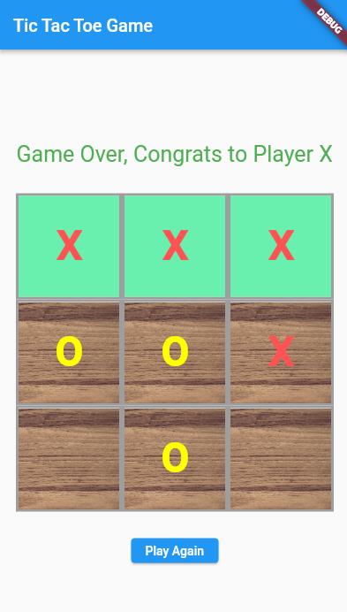
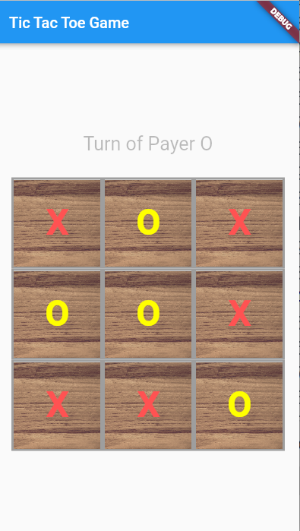
Coloring the winning Cells ?
When it is a draw ?

Slide 45
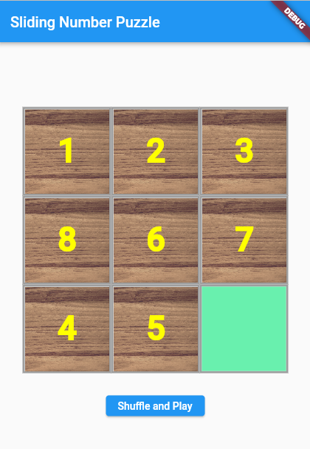
More Interactivity for Flutter Apps
Sliding Number Puzzle
Flutter UI

Slide 46
More Interactivity for Flutter Apps
Sliding Number Puzzle
Data Structures

Slide 47
List<List<String>> data = [];
int gridSize = 3;
int empty_row = 2;
int empty_col = 2;
void init_game_data() {
data = [];
empty_row = gridSize - 1;
empty_col = gridSize - 1;
int inc = 1;
for (int r = 0; r < gridSize; r++) {
List<String> row = [];
for (int c = 0; c < gridSize; c++) {
row.add(inc.toString());
inc = inc + 1;
}
data.add(row);
}
data[gridSize - 1][gridSize - 1] = '';
}

Slide 48
Widget getCell(int row, int col) {
return GestureDetector(
onTap: () {
bool ret = moveSquare(row, col);
if (ret) setState(() {});
},
child: Container(
decoration: BoxDecoration(
border: Border.all(color: Colors.grey, width: 3),),
width: 120,
height: 120,
child: Stack(
children: [
if (data[row][col] != '')
Positioned.fill(
child: Opacity(
opacity: 0.8,
child:
Image.asset('assets/images/wood.png', fit: BoxFit.cover),),),
if (data[row][col] == '')
Container(color: Colors.greenAccent),
Center(
child: Text('${data[row][col]}',
style: const TextStyle(
fontSize: 45,
fontWeight: FontWeight.bold,
color: Colors.yellowAccent))),
],
), ), ); }

Slide 49
More Interactivity for Flutter Apps
Sliding Number Puzzle
Doing the shuffle ?

Slide 50
Section 2
Navigation and Routes

Slide 51
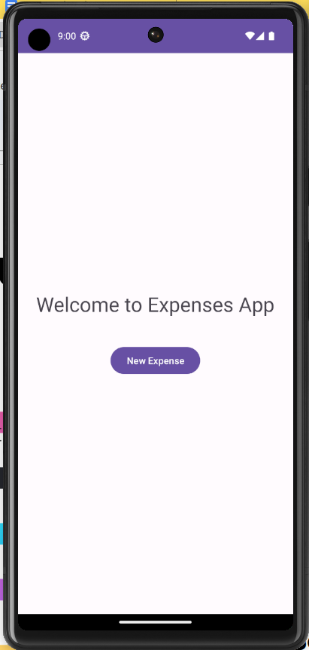
Navigation across Multiple Screens in Flutter
Expenses App
New Expense
List of Expenses
Reminder for Android Native Development/Kotlin
override fun onCreate(savedInstanceState: Bundle?) {
super.onCreate(savedInstanceState)
setContentView(R.layout.activity_main)
var bt_new=findViewById<Button>(R.id.bt_new)
bt_new.setOnClickListener {
val intent = Intent(this, NewExpense::class.java)
intent.putExtra("some_variable", "HelloWorld !")
intent.putExtra("another_variable", 12)
this.startActivity(intent)
}
}
New Expense
Description
Amount
Date
Add

Slide 52
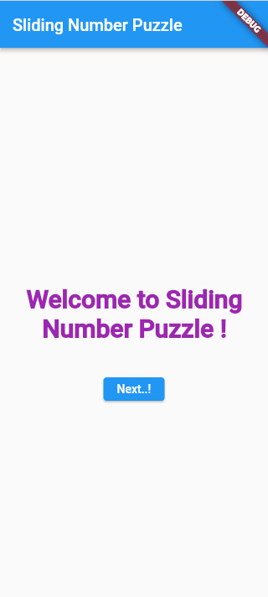
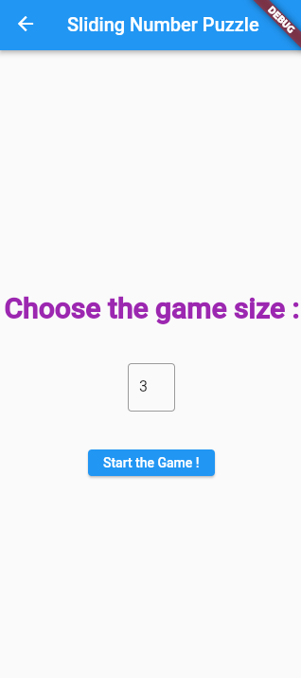
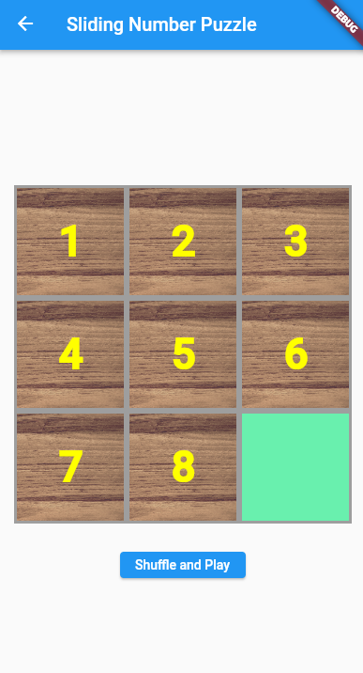
Navigation across Multiple Screens in Flutter
Sliding Number Puzzle :
Three Screens
Welcome Screen
welcome.dart
Customize Screen
customize.dart
Game Screen
game.dart

Slide 53
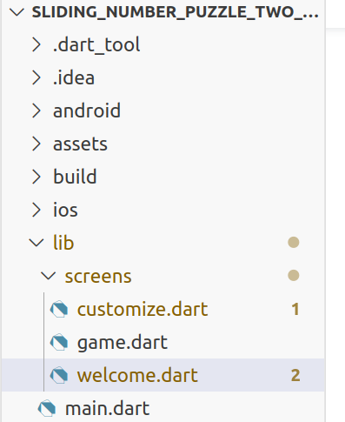
Navigation across Multiple Screens in Flutter
Sliding Number Puzzle :
Three Screens
Welcome Screen
welcome.dart
Customize Screen
customize.dart
Game Screen
game.dart

Slide 54
Navigation across Multiple Screens in Flutter
import 'package:flutter/material.dart';
import 'package:sliding_number_puzzle_two_screens/screens/customize.dart';
import 'package:sliding_number_puzzle_two_screens/screens/game.dart';
import 'package:sliding_number_puzzle_two_screens/screens/welcome.dart';
void main() {
runApp(const MainApp());
}
class MainApp extends StatelessWidget {
const MainApp({super.key});
@override
Widget build(BuildContext context) {
return MaterialApp(
home: WelcomeScreen(),
routes: {
HomeScreen.pageRoute: (ctx) => HomeScreen(),
WelcomeScreen.pageRoute: (ctx) => WelcomeScreen(),
CustomizeScreen.pageRoute: (ctx) => CustomizeScreen(),
},
);
}
}
Sliding Number Puzzle :
main.dart File :

Slide 55
Navigation across Multiple Screens in Flutter
Routes and Navigation in Flutter
main.dart File :

Slide 56
Navigation across Multiple Screens in Flutter
import 'package:flutter/material.dart';
import 'package:sliding_number_puzzle_two_screens/screens/customize.dart';
class WelcomeScreen extends StatelessWidget {
static const String pageRoute = '/welcomescreen';
@override
Widget build(BuildContext context) {
return Scaffold(
appBar: AppBar(title: const Text('Sliding Number Puzzle')),
body: Center(
child: Column(
mainAxisAlignment: MainAxisAlignment.center,
crossAxisAlignment: CrossAxisAlignment.center,
children: [
const Text(
'Welcome to Sliding Number Puzzle !',
textAlign: TextAlign.center,
style: TextStyle(
color: Colors.purple,
fontWeight: FontWeight.bold,
fontSize: 30),
),
const SizedBox(height: 40),
ElevatedButton(
onPressed: () {
Navigator.pushNamed(context, CustomizeScreen.pageRoute);
},
child: Text("Next..!"),
),
]),
),
);
}
}
Sliding Number Puzzle :
Welcome Screen :

Slide 57
Navigation across Multiple Screens in Flutter
Second Screen : Customize.dart
Stateless or Stateful ?

Slide 58
Navigation across Multiple Screens in Flutter
Second Screen : Customize.dart
Stateless or Stateful ? (Of course, you can make everything stateful at the expense of performance)
It has a TextFormField ( It’s value can change ? )

Slide 59
Navigation across Multiple Screens in Flutter
Second Screen : Customize.dart
Stateless or Stateful ? (Of course, you can make everything stateful at the expense of performance)
It has a TextFormField ( It’s value can change ? )
If you don’t need to refresh the UI with a dynamic value, stateless would do. ( Input entered by the user does not require UI refresh, whilst the slider/switch need a refresh)

Slide 60
import 'package:flutter/material.dart';
import 'package:sliding_number_puzzle_two_screens/screens/game.dart';
class CustomizeScreen extends StatelessWidget {
static const String pageRoute = '/customizescreen';
String _tx_size_value = '3';
@override
Widget build(BuildContext context) {
return Scaffold(
appBar: AppBar(title: const Text('Sliding Number Puzzle')),
body: Center(
child: Column(
mainAxisAlignment: MainAxisAlignment.center,
crossAxisAlignment: CrossAxisAlignment.center,
children: [
...
]),
),
);
}
}
You can have instance variable in a stateless widget

Slide 61
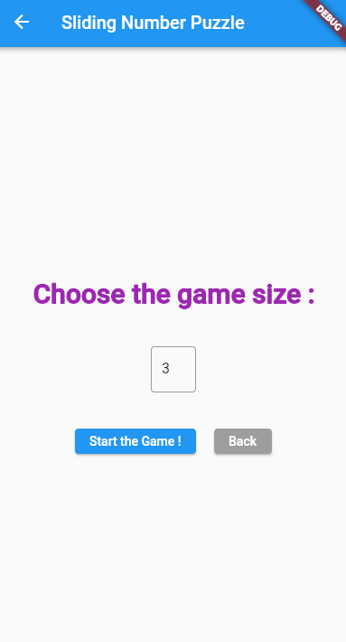
ElevatedButton(
onPressed: () {
Navigator.pushNamed(context, WelcomeScreen.pageRoute);
},
child: Text('Back'),
OR ?
ElevatedButton(
onPressed: () {
Navigator.pop(context);
},
child: Text('Back'),

Slide 62
The value 3 needs to be sent to the child screen ( next screen )
Remember : Flutter is declarative
Not imperative programming : ( someRef.getText( ) no longer works )

Slide 63
children: [
const Text(
'Choose the game size : ', textAlign: TextAlign.center,
style: TextStyle(
color: Colors.purple,
fontWeight: FontWeight.bold, fontSize: 30),
),
const SizedBox(height: 40),
SizedBox(
width: 50,
child: TextFormField(
decoration: const InputDecoration(
border: OutlineInputBorder(
borderSide: BorderSide(color: Colors.teal)),
),
initialValue: '3',
keyboardType: TextInputType.number,
onChanged: (newValue) {
debugPrint('> Printing new value $newValue');
_tx_size_value = newValue;
},
),
),
const SizedBox(height: 40),
ElevatedButton(
onPressed: () {
Navigator.of(context).push(MaterialPageRoute(
builder: (context) => HomeScreen(myData: {
'myBoardSize': _tx_size_value,
'otherDataYouWish': 'hello',
})));
},
child: Text("Start the Game !"),
),
]),
),
);
}
}

Slide 64
Navigation across Multiple Screens in Flutter
Passing Data between Screens :
The recommended way is to pass through the child constructor.
You may can use a Map Object to pass a variety of variables.

Slide 65
Navigation across Multiple Screens in Flutter
Passing Data between Screens :
Another way
Navigator.pushNamed(context, someRoute, arguments: [
'Title of Screen',
['data', 'another data'],
'some more'
]),
Sending
@override
Widget build(BuildContext context) {
final List args = (ModalRoute.of(context)!.settings.arguments) as List;
appbarTitle = args[0];
listOfItems = args[1];
infoOrState = args[2];
Getting

Slide 66
Navigation across Multiple Screens in Flutter
Third Screen : game.dart
Must be stateful
How to get the data passed from the parent screen ?

Slide 67
Navigation across Multiple Screens in Flutter
Third Screen : game.dart
Must be stateful
How to get the data passed from the parent screen ?
import 'dart:math';
import 'package:flutter/material.dart';
class HomeScreen extends StatefulWidget {
static const String pageRoute = '/homescreen';
final Map<String, String>? myData;
const HomeScreen({super.key, this.myData});
@override
_HomeScreenState createState() => _HomeScreenState();
}

Slide 68
Navigation across Multiple Screens in Flutter
Third Screen : game.dart
Must be stateful
How to get the data passed from the parent screen ?
import 'dart:math';
import 'package:flutter/material.dart';
class HomeScreen extends StatefulWidget {
static const String pageRoute = '/homescreen';
final Map<String, String>? myData;
const HomeScreen({super.key, this.myData});
@override
_HomeScreenState createState() => _HomeScreenState();
}
How to pass the data to the Widget State Object ?

Slide 69
Navigation across Multiple Screens in Flutter
class _HomeScreenState extends State<HomeScreen> {
List<List<String>> data = [];
int gridSize = 3;
int empty_row = 2;
int empty_col = 2;
void init_game_data() {
try {
gridSize = int.parse(widget.myData!['myBoardSize']!);
} catch (e) { gridSize = 3; }
data = [];
empty_row = gridSize - 1;
empty_col = gridSize - 1;
int inc = 1;
for (int r = 0; r < gridSize; r++) {
List<String> row = [];
for (int c = 0; c < gridSize; c++) {
row.add(inc.toString());
inc = inc + 1;
}
data.add(row);
}
data[gridSize - 1][gridSize - 1] = '';
}
@override
void initState() {
super.initState();
init_game_data();
}
Third Screen : game.dart
Must be stateful
How to get the data passed from the parent screen ?

Slide 70
Navigation across Multiple Screens in Flutter
Passing Data between Screens : Other ways ?
The recommended way is to pass through the child constructor.
You may can use a Map Object to pass a variety of variables.

Slide 71
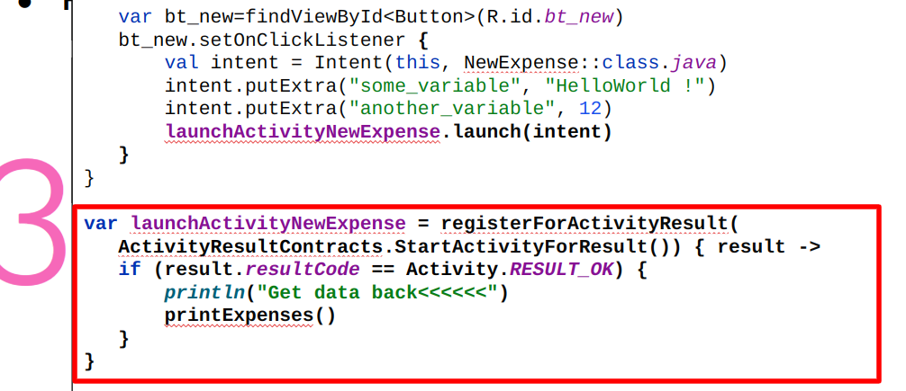
Navigation across Multiple Screens in Flutter
Ack from the Child to Parent when the Child is killed ?
In Kotlin

Slide 72
Navigation across Multiple Screens in Flutter
Validating User Input
Define a global key variable for the form
Wrap the form elements with Form, with the key attribute variable.
Define the validator attribute for the TextFormfield to return error message in case
On submit the form, call the form validate() method.

Slide 73
Navigation across Multiple Screens in Flutter
Validating User Input
Define a global key variable for the form
Wrap the form elements with Form, with the key attribute variable.
Define the validator attribute for the TextFormfield to return error message in case
On submit the form, call the form validate() method.
class CustomizeScreen extends StatelessWidget {
static const String pageRoute = '/customizescreen';
String _tx_size_value = '3';
final _formKey = GlobalKey<FormState>();

Slide 74
Navigation across Multiple Screens in Flutter
Validating User Input
Define a global key variable for the form
Wrap the form elements with Form, with the key attribute variable.
Define the validator attribute for the TextFormfield to return error message in case
On submit the form, call the form validate() method.
@override
Widget build(BuildContext context) {
return Scaffold(
appBar: AppBar(title: const Text('Sliding Number Puzzle')),
body: Form(
key: _formKey,
child: Center(
child: Column(

Slide 75
Navigation across Multiple Screens in Flutter
child: TextFormField(
initialValue: '3',
keyboardType: TextInputType.number,
onChanged: (newValue) {
debugPrint('> Printing new value $newValue');
_tx_size_value = newValue;
},
validator: (value) {
if (value == null ||
int.tryParse(value.toString()) == null) {
return 'invalid number';
}
return null;
},
Validating User Input
Define a global key variable for the form
Wrap the form elements with Form, with the key attribute variable.
Define the validator attribute for the TextFormField to return error message in case
On submit the form, call the form validate() method.

Slide 76
Navigation across Multiple Screens in Flutter
ElevatedButton(
onPressed: () {
if (!_formKey.currentState!.validate()) {
return;
}
Navigator.of(context).push(MaterialPageRoute(
builder: (context) => HomeScreen(myData: {
'myBoardSize': _tx_size_value,
'otherDataYouWish': 'hello',
})));
},
child: Text("Start the Game !"),
),
Validating User Input
Define a global key variable for the form
Wrap the form elements with Form, with the key attribute variable.
Define the validator attribute for the TextFormField to return error message in case
On submitting the form, call the form validate() method.

Slide 77
Section 3
Navigational Widgets

Slide 78
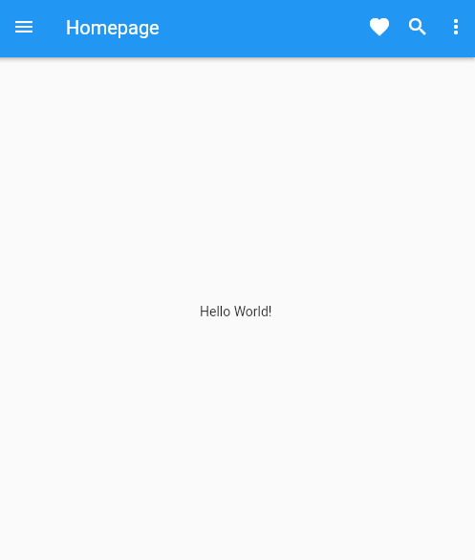
Navigational Widgets for Flutter Apps
import 'package:flutter/material.dart';
import 'package:navigation_hello_world/widgets/appbar.dart';
void main() {
runApp(const MainApp());
}
class MainApp extends StatelessWidget {
const MainApp({super.key});
@override
Widget build(BuildContext context) {
return MaterialApp(
debugShowCheckedModeBanner: false,
home: Scaffold(
appBar: MyAppBar(myTitle: 'Homepage'),
body: Center(
child: Text('Hello World!'),
),
),
);
}
}
AppBar

Slide 79
Navigational Widgets for Flutter Apps
import 'package:flutter/material.dart';
class MyAppBar extends StatelessWidget implements PreferredSizeWidget {
String myTitle;
@override
final Size preferredSize = const Size.fromHeight(60.0);
MyAppBar({super.key, this.myTitle = ''});
@override
Widget build(BuildContext context) {
return AppBar(
leading: IconButton(
icon: const Icon(Icons.menu),
onPressed: () {},
),
title: Text(myTitle),
actions: [
IconButton(icon: const Icon(Icons.favorite),onPressed: () {},),
IconButton(icon: const Icon(Icons.search),onPressed: () {},),
PopupMenuButton<Text>(
itemBuilder: (context) {
return [
const PopupMenuItem(child: Text('Option 1'),),
const PopupMenuItem(child: Text('Option 2'),),
];
},
)
],
);
}
}
This is a stateless Widget, if you want to interact with the fav button, it needs to be converted to a stateful widget
AppBar

Slide 80
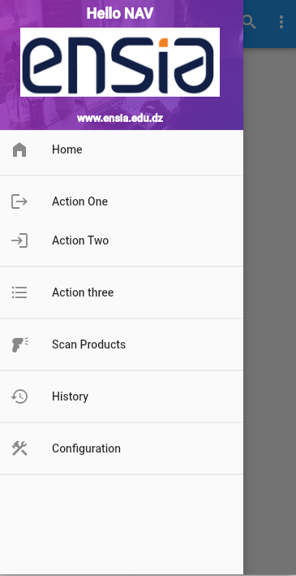
Navigational Widgets for Flutter Apps
import 'package:flutter/material.dart';
import '../widgets/appbar.dart';
import '../widgets/drawer.dart';
class HomeScreen extends StatefulWidget {
static const String pageRoute = '/homescreen';
const HomeScreen({super.key});
@override
State<HomeScreen> createState() => _HomeScreenState();
}
class _HomeScreenState extends State<HomeScreen> {
@override
Widget build(BuildContext context) {
return Scaffold(
drawer: const SideBarDrawer(),
appBar: MyAppBar(
myTitle: 'Homepage',
),
body: const Center(
child: Text('Hello World!'),
));
}
}
Drawer

Slide 81
Navigational Widgets for Flutter Apps
import 'package:flutter/material.dart';
class MyAppBar extends StatelessWidget implements PreferredSizeWidget {
String myTitle;
@override
final Size preferredSize = const Size.fromHeight(60.0);
MyAppBar({super.key, this.myTitle = ''});
@override
Widget build(BuildContext context) {
return AppBar(
leading: IconButton(
icon: const Icon(Icons.menu),
onPressed: () {},
),
title: Text(myTitle),
actions: [
IconButton(icon: const Icon(Icons.favorite),onPressed: () {},),
IconButton(icon: const Icon(Icons.search),onPressed: () {},),
PopupMenuButton<Text>(
itemBuilder: (context) {
return [
const PopupMenuItem(child: Text('Option 1'),),
const PopupMenuItem(child: Text('Option 2'),),
];
},
)
],
);
}
}
AppBar
Must be removed

Slide 82
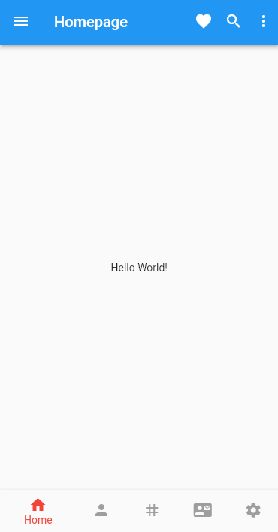
Navigational Widgets for Flutter Apps
Other ways for navigation & interaction :
Bottom Bar
Floating Buttons
Tabs
..

Slide 83
Lecture Demo Apps
Reminder Examples
https://www.dropbox.com/scl/fo/ddnkks2s0k9qfw9lfx8ru/h?rlkey=c972kn3tsqjicthtgu4wekhp3&dl=0
https://www.dropbox.com/scl/fo/hm3mkdvnhibf4macm78as/h?rlkey=zga7oxols3l72a82qt5kspui1&dl=0
Tic Tac Toe Game
Without Business Logic:
https://www.dropbox.com/scl/fo/oskfiozepgyppc6z3lfmo/h?rlkey=0v2gwcgcw7w6nbstsqte58f78&dl=0
With Business Logic
https://www.dropbox.com/scl/fo/wv42hnx4r83g7huzhuc6e/h?rlkey=k4cx70oxnynv7cq5wclwcyndm&dl=0
Sliding Number Puzzle :
https://www.dropbox.com/scl/fo/tg5sgw9c72ekngs9u2zjm/h?rlkey=82a1jir7c66pdj7mjx0b7kp6d&dl=0
Sliding Number Puzzle with Multiple Screens + Form validation :
https://www.dropbox.com/scl/fo/43h6f5uwgp98uywe2p4rq/h?rlkey=586k5xctnmi75nf1jwl0hugc3&dl=0

Slide 84
Resources
https://docs.flutter.dev/cookbook/navigation/named-routes
https://docs.flutter.dev/ui/navigation
https://docs.flutter.dev/cookbook/design/tabs

Slide 85

← Sport Activity
Title here
Big Title
Big description here …Big description here …Big description here …Big description here …Big description here …Big description here …Big description here …Big description here …Big description here …Big description here …Big description here …

